Slide 1
CS 408
Computer Networks
Chapter 15
Local Area Networks

Slide 2
LAN (Local Area Networks)
A LAN is a computer network that covers a small area (home, office, building, campus)
  a few kilometers
LANs have higher data rates (10Mbps to 40Gbps) as compared to WANs
LANs (usually) do not involve leased lines; cabling and equipments belong to the LAN owner.
A LAN consists of
  Shared transmission medium
    now so valid today due to switched LANs (for wired LANs), but still valid for wireless LANs
  regulations for orderly access to the medium
  set of hardware and software for the interfacing devices

Slide 3
LAN Protocol Architecture
Corresponds to lower two layers of OSI model
  But mostly LANs do not follow OSI model
Current LANs are most likely to be based on Ethernet protocols developed by IEEE 802 committee
IEEE 802 reference model
  Logical link control (LLC)
  Media access control (MAC)
  Physical

Slide 4
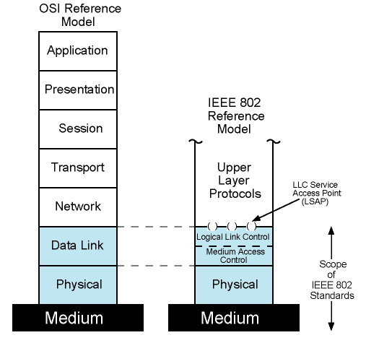
IEEE 802 Protocol Layers vs. OSI Model

Slide 5
IEEE 802 Layers - Physical
Signal encoding/decoding
Preamble generation/removal
  for synchronization
Bit transmission/reception
Specification for topology and transmission medium

Slide 6
802 Layers - Medium Access Control & Logical Link Control
OSI layer 2 (Data Link) is divided into two in IEEE 802
  Logical Link Control (LLC) layer
  Medium Access Control (MAC) layer
LLC layer
  Interface to higher levels
  flow control
  Based on classical Data Link Control Protocols (so we will cover later)
MAC layer
  Prepare data for transmission
  Error detection
  Address recognition
  Govern access to transmission medium
    Not found in traditional layer 2 data link control

Slide 7
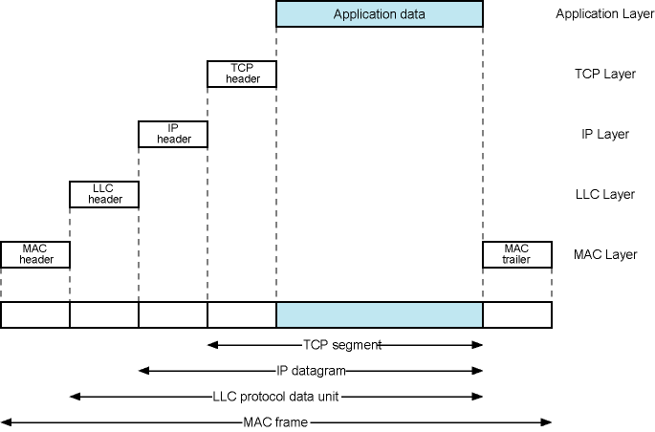
LAN Protocols in Context

Slide 8
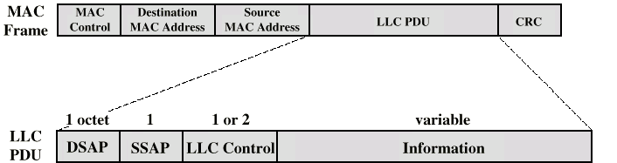
Generic MAC & LLC Format
Actual format differs from protocol to protocol
MAC layer receives data from LLC layer
MAC layer detects errors and discards frames
LLC optionally retransmits unsuccessful frames

Slide 9
LAN Topologies
Bus
Ring
Star

Slide 10
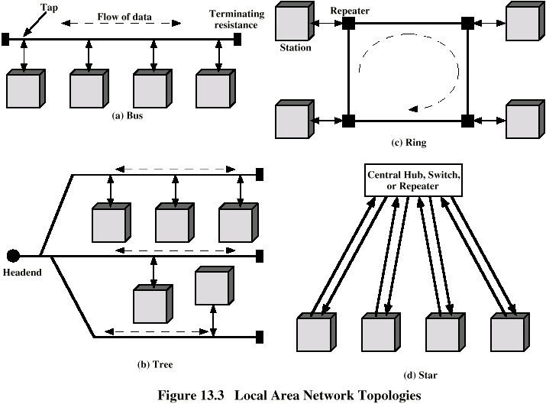
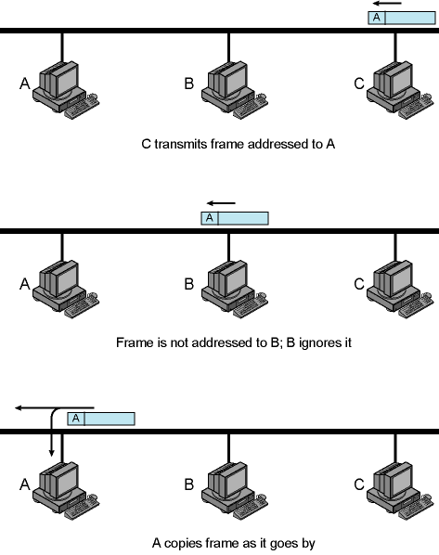
Bus Topology - 1
Stations attach to linear medium (bus)
  Via a tap - allows for transmission and reception
Transmission propagates in medium in both directions
Received by all other stations
  Not addressed stations ignore
Need to identify target station
  Each station has unique address
  Destination address included in frame header
Terminator absorbs frames at the end of medium

Slide 11
Bus Topology - 2
Need to regulate transmission; mainly due to two reasons:
  To avoid collisions
    If two stations attempt to transmit at same time, signals will overlap and become garbage
  To avoid continuous transmission from a single station. If one station transmits continuously, access is blocked for others
    Solution: Transmit Data in small blocks – frames

Slide 12
Ring Topology
Repeaters joined by point-
to-point links in closed loop
  Links are unidirectional
  Receive data on one link and retransmit on another
  Stations attach to repeaters
Data transmitted in frames
  Frame passes all stations in a circular manner
  Destination recognizes address and copies frame
  Frame circulates back to source where it is removed
Medium access control is needed to determine when station can insert frame

Slide 13
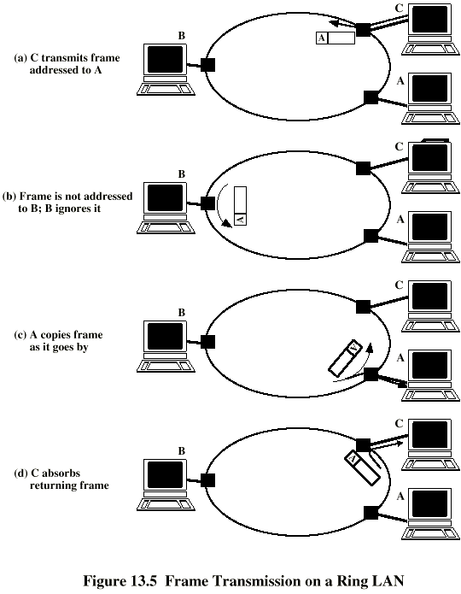
Frame
Transmission
Ring LAN

Slide 14
Star Topology
Hub or Switch
Each station connected
directly to central node
  using a full-duplex
  (bi-directional) link
Central node can broadcast (hub)
  Physical star, but logically like bus due to broadcast medium
  Only one station can transmit at a time; otherwise, collision occurs
Central node can act as frame switch
  retransmits only to destination
  today’s technology

Slide 15
Medium Access Control (MAC)
Traditionally, in LANs data is broadcast
  there is a single medium shared by different users
We need MAC sublayer for
  orderly and efficient use of broadcast medium
This is actually a “channel allocation” problem
Synchronous (static) solutions
  everyone knows when to transmit
Asynchronous (dynamic) solution
  in response to immediate needs
  Two categories
    Round robin
    Contention

Slide 16
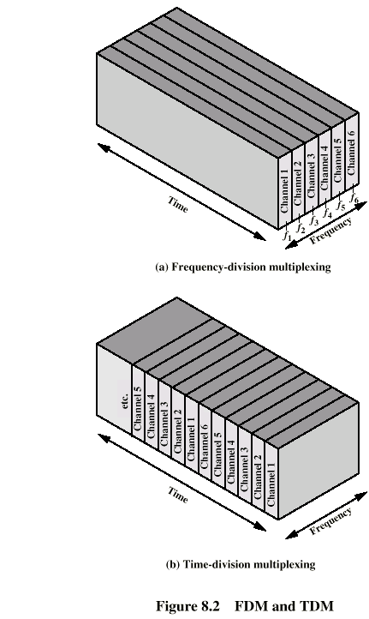
Static Channel Allocation
Frequency Division Multiplexing (FDM)
Channel is divided to carry different signals at different frequencies
Efficient if there is a constant (one for each slot) amount of users with continous traffic
Problematic if there are less or more users
Even if the amount of users = # of channels, utilization is still low since typical network traffic is not uniform and some users may not have something to send all the time

Slide 17
Static Channel Allocation
Time Division Multiplexing
Each user is statically allocated one time slot
  if a particular user does not have anything to send, it remains idle and wastes the channel for that period
  A user may not utilize the whole channel for a time slot
Thus, inefficient.

Slide 18
Dynamic Channel Allocation Categories
Round robin
  each station has a turn to transmit
    declines or transmits up to a certain data limit
    overhead of passing the turn in either case
  Performs well if many stations have data to transmit for most of the time
    otherwise passing the turn would cause inefficiency

Slide 19
Dynamic Channel Allocation Categories
Contention
  All stations contend to transmit
  No control to determine whose turn is it
  Stations send data by taking risk of collision (with others’ packets)
    however they understand collisions by listening to the channel, so that they can retransmit
  There are several contention-based methods
  In general, good for bursty traffic
    which is the typical traffic types for most networks
    Bursty traffic: sending data continuously for some time and then remain idle for longer period of time
  Efficient under light or moderate load
  Performance is bad under heavy load

Slide 20

Ethernet (CSMA/CD)
Carriers Sense Multiple Access with Collision Detection
  is the underlying technology (protocol) for medium access control
Xerox – Ethernet (1976)
by Metcalfe
IEEE 802.3 – standard (1983)
Contention technique that has basis in famous ALOHA network
Notes:
The name of Ethernet comes from Luminiferous Ether, a light-bearing substance that is believed to be existing for light propagation and covers the space. In the late 19th century, it has been proven that Ether does not exist and light can propagate in vacuums (Michelson–Morley experiment (1887)).
Luminifirıs

Slide 21
ALOHA
Packet Radio (applicable to any shared medium)
  initially proposed to interconnect Hawaiian Islands (several stations)
    by Norman Abramson of Univ. of Hawaii (early 70s)
    Later inspired the designers of Ethernet
When station has frame, it sends
  collisions may occur
Station listens for max round trip time
If no collision, fine. If collision, retransmit after a random waiting time
  Collison is understood by listening or by having no acknowledgement (two alternatives – see the notes of this slide)
Max channel utilization is 18% - very bad
Notes:
Two explanations for Aloha in books.
1) Single channel where all stations broadcast. Collisions are detected by listening to the channel
2) There is a central node (hub) and several end points (secondary station). There are two channels. Upstream channel is to central from end points; downstream channel is from central to end points. Whenever an endpoint has something to send to another end point, it sends to central via upstream channel. If received successfully, central resends it to all secondaries via downstream channel. Moreover, the sender also receives an acknowledgment via downstream channel. There is no collision problem on downstream channel, but if more than one secondary station transmit at the same time, then collision occurs on the upstream channel. In such a case, sender retransmits after a random waiting time.

Slide 22
Slotted ALOHA
Divide the time into discrete intervals (slots)
  equal to frame transmission time
  need central clock (or other sync mechanism)
  transmission begins at slot boundary
Collided frames will do so totally or will not collide
Algorithm
  If a node has a packet to send, sends it at the beginning of the next slot
  If collision occurred, retransmit at the next slot with a probability
    Why with a probability?
Max channel utilization is 37%
  doubles Normal ALOHA, but still low
Notes:
Because, collision means more than one node needs to send. If both retransmit immediately, again collision occurs.

Slide 23
CSMA (Carrier Sense Multiple Access)
First listen for clear medium (carrier sense)
If medium idle, transmit
If busy, continuously check the channel until it is idle and then transmit
If collision occurs
  Wait random time and retransmit (called back-off )
Collision probability depends on the propagation delay
  Longer propagation delay, worse the utilization
Collision may occur even if the propagation time is zero.
  WHY?
This method is called as 1-persistent CSMA
Better utilization than ALOHA

Slide 24
Nonpersistent CSMA
Patient CSMA
If channel idle, send
If not, do not continuously seize the channel
  instead wait a random period of time and sense the channel again
Better utilization, longer delay

Slide 25
p-Persistent CSMA
Applies to slotted channels
If channel is busy, then check the next slot
If channel is idle
  send with a probability p
  defer until the next slot with probability 1 – p
  repeat this algorithm until it sends or channel becomes busy by another station
    if channel becomes busy in one of these slots, wait until channel is available and repeat the same algorithm
    if collision occurs, then wait a random period of time and repeat the same algorithm
larger p means smaller channel utilization and smaller waiting time for the packets

Slide 26
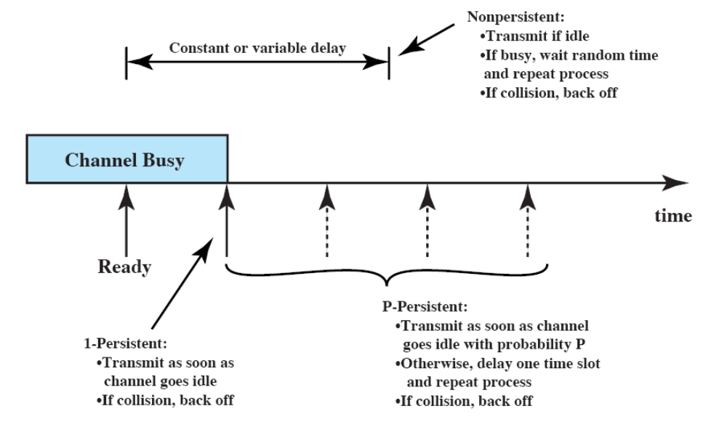
All CSMA Persistence schemes altogether

Slide 27
CSMA/CD (IEEE 802.3 – Ethernet)
As in 1-persistent CSMA, but uses slotted channels
  If medium idle, transmit
  If busy, listen for idle slot, then transmit
In regular CSMA, collision occupies medium for duration of transmission
  it is inefficient to complete the transmission of a collided packet
In CSMA/CD, stations listen while transmitting
If collision detected (due to high voltage on bus), cease transmission and wait random time then start again
  random waiting time is determined using binary exponential backoff mechanism

Slide 28
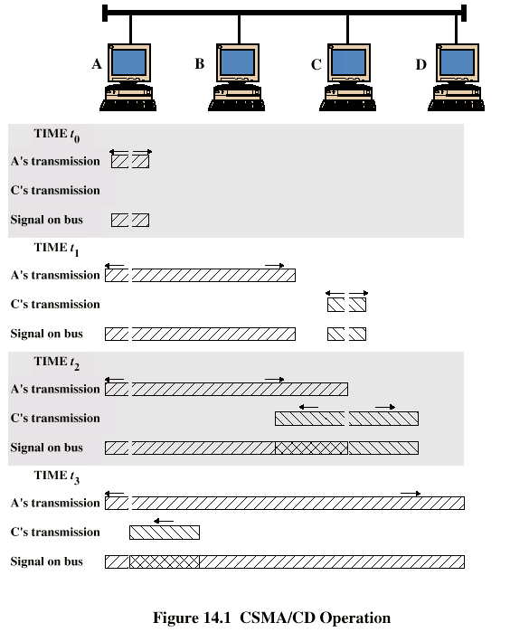
CSMA/CD
Operation

Slide 29
Binary exponential back off
random waiting period but consecutive collisions increase the mean waiting time
  mean waiting time doubles in the first 10 retransmission attempts
  after first collision, waits 0 or 1 slot time (selected at random)
  if collided again (second time), waits 0, 1, 2 or 3 slots (at random)
  if collided for the i^{th} time, waits 0, 1, …, or 2^{i}-1 slots (at random)
  the randomization interval is fixed to 0 … 1023 after 10th collision
  station tries a total of 16 times and then gives up if cannot transmit
low delay with small amount of waiting stations
large delay with large amount of waiting stations
one slot time = max. round trip delay ≈ 50 microsecs in 10 Mbps Ethernet (see next slide for details of this value)

Slide 30
CSMA/CD - Details of Contention
No acknowledgments in CSMA/CD, so sending station must make sure that:
  all other stations are aware of its transmission and
  there is no collision on the channel
so the sending station has to continue transmission for a duration of the worst case scenario in which understanding a collision takes as long as the round trip time
  this is closely related to the length of the cable (bus) and the propagation speed
  for 2500 meters of coax cable (standard for 10 Mbps Ethernet), round trip time is approx 50 microseconds

Slide 31
Minimum Frame Size
Previous discussion also has minimum frame size implication
  at 10 Mbps: one bit takes 100 ns to be transmitted
  In order to occupy the channel during 50 microsecs
    one frame at minimum should be 500 bits
    plus some safety margins and rounding, minimum frame size is set to 512 bits (64 bytes) in IEEE 802.3

Slide 32
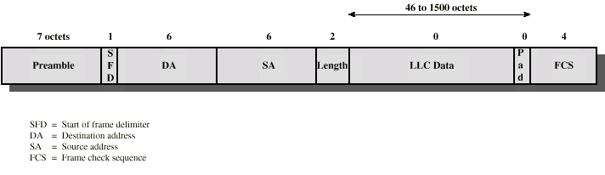
IEEE 802.3 Frame Format
>=
>=
Preamble is alternating 1’s and 0’s (for clock synchronization)
SFD is 10101011
Length is of the LLC data
FCS is 32-bit CRC (Cyclic Redundancy Check) code and excludes Preamble and SFD
Addresses are uniquely assigned by IEEE to manufacturers. Why unique?

Slide 33
CSMA/CD Performance
Formulation for utilization
  utilization = transmission time / (trans. time + all other)
  If no collisions ➔ U = T_{trans} / (T_{trans} + T_{prop})
  With collisions ➔ U = T_{trans} / (T_{trans} + T_{prop} + T_{contention})
  T_{contention} is the time spent for collisions to send a frame
  We have seen how to formulate trans. and prop. delays before. Now we shall see (on the board) how to formulate contention time

Slide 34
10Mbps Medium Options
10Base2
  Thin coax - obsolete
10Base5
  Thick coax
  Bus topology
  500meters max segment length
    max 5 segments connected via repeaters → max. 2500 meters
  Max. 100 stations per segment
10BaseT
  most commonly used 10 Mbps option (see next slide)
10BaseF
  Optical fiber
  star topology or point to point
  too expensive for 10 Mbps

Slide 35
10BASE-T
Unshielded twisted pair (UTP) medium
  regular telephone wiring
Point to point using cross-cables
Star-shaped topology
  Stations connected to central hub or switch
  Two twisted pairs (transmit and receive)
  Hub accepts input on any one line and repeats it on all other lines
    Physical star, logical bus
    collisions are possible
Link limited to 100 m
Multiple levels of hubs can be cascaded

Slide 36
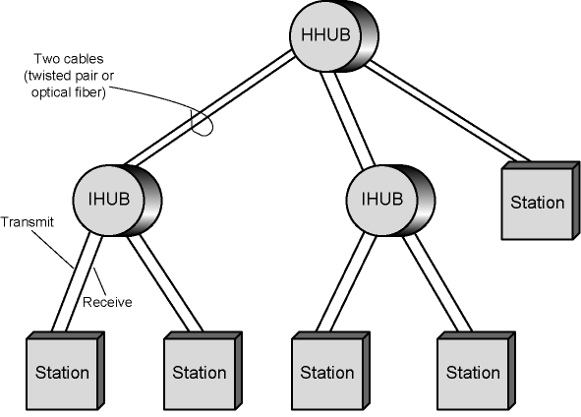
An Example Two-Level Star Topology

Slide 37
Interconnection Elements in LANs
Hubs
Bridges
Switches
Routers

Slide 38
Bridges
Need to expand beyond single LAN
Interconnection to other LANs and WANs
Use Bridge or Router (Switches can also be used)
Bridge is simpler
  Connects similar LANs
  Identical protocols for physical and link layers
  Minimal processing
Router is more general purpose
  Interconnect various LANs and WANs

Slide 39
Functions of a Bridge
Read all frames transmitted on one LAN and accept those addressed to any station on the other LAN
Retransmit each frame on second LAN
Do the same the other way round

Slide 40
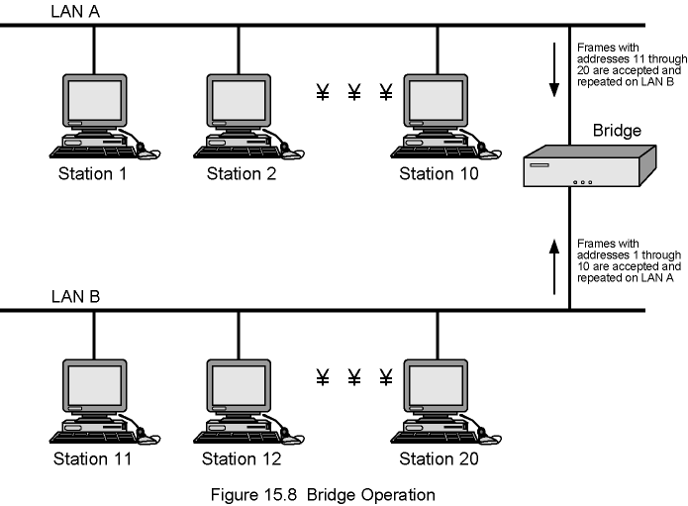
Bridge Operation Example

Slide 41
Bridge Design Aspects
No modification to content or format of frame
No additional header
Exact bitwise copy of frame from one LAN to another
  that is why two LANs must be identical
Enough buffering to meet peak demand
May connect more than two LANs
Routing and addressing intelligence
  Must know the addresses on each LAN to be able to tell which frames to pass
  May be more than one bridge to reach the destination
Bridging is transparent to stations
  All stations on multiple LANs think that they are on one single LAN

Slide 42
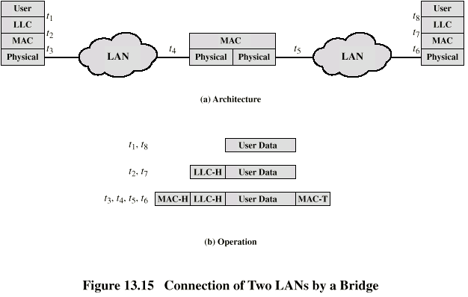
Bridge Protocol Architecture
IEEE 802.1D
operates at MAC level
  Station address is at this level
  Bridge does not need LLC layer

Slide 43
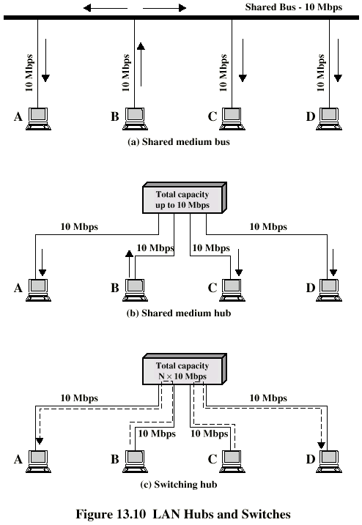
Shared Medium Hub
Central hub for constituting a LAN (No interconnection)
Hub retransmits incoming signal to all outgoing lines
Only one station can transmit at a time
With a 10Mbps LAN, total capacity is 10Mbps
  i.e. total capacity is the shared capacity

Slide 44
Layer 2 Switches
Central repeater acts as switch
Incoming frame switches to appropriate outgoing line
  Other lines can be used to switch other traffic
  More than one station transmitting at a time
  Each device has dedicated capacity equal to the LAN capacity, if the switch has sufficient capacity for all
MAC and LLC layers are implemented (No IP layer)

Slide 45
Types of Layer 2 Switch
Store and forward switch
  Accept input, buffer it briefly, then output
Cut through switch
  Take advantage of the destination address being at the start of the frame
  Begin repeating incoming frame onto output line as soon as address recognized
  May propagate some bad frames
    WHY?
Notes:
Because CRC (FCS) control bits are at the end of the frame and all frame is needed to verify CRC (FCS)

Slide 46
Layer 2 Switch vs. Bridge
Bridge functionality also exists in layer 2 switches
Some differences
  Bridge only analyzes and forwards one frame at a time
  Switch has multiple parallel data paths
    Can handle multiple frames at a time
  Bridge uses store-and-forward operation
  Switch also has cut-through operation
  Bridge implements Physical and MAC layers only; Layer 2 Switches also have LLC layer.
Bridges are not common nowadays
  New installations typically include layer 2 switches with bridge functionality rather than bridges

Slide 47
Problems with Layer 2 Switches (1)
As number of devices in LANs grows, layer 2 switches show some limitations
  Broadcast overload
    In LANs some protocols (e.g. ARP) work in broadcast manner
  Lack of multiple routes
Set of devices and LANs connected by layer 2 switches share common MAC broadcast address
  If any device issues broadcast frame, that frame is delivered to all devices attached to network connected by layer 2 switches and/or bridges
  In large network, broadcast frames can create a significant overhead

Slide 48
Problems with Layer 2 Switches (2) and Solution
Current standards dictate no closed loops
  Only one route is allowed between any two devices
    Limits both performance and reliability.
Solution: break up network into subnetworks connected by routers (that operate at IP layer)
  MAC broadcast frames are limited to devices and switches contained in single subnetwork
  IP-based routers employ sophisticated routing algorithms
    Allow use of multiple routes between subnetworks going through different routers

Slide 49
Problems with Routers;
Layer 3 Switches
Routers are designed to be implemented in software at the gateway and only process packets to/from outer networks
  outside traffic is less than the internal traffic
  the same router may create a performance bottleneck in the heart of a LAN
    High-speed LANs and high-performance layer 2 switches pump millions of packets per second
Solution: layer 3 switches
  Implement IP and the layers below (as in the router)
  Implement packet-forwarding logic of router in hardware
    faster
Two categories
  Packet by packet
  Flow based
  Read the book for details if interested (not responsible)

Slide 50
Typical (low cost) Large LAN Organization
Thousands to tens of thousands of devices
Desktop systems links 10 Mbps to 100 Mbps
  Into layer 2 switch
Wireless LAN connectivity available for mobile users
Layer 3 switches at local network's core
  Form local backbone
  Interconnected at 1 Gbps
  Connect to layer 2 switches at 1 Gbps
Servers connect directly to layer 2 or layer 3 switches at 1 Gbps
Router provides WAN connection
Circles in diagram identify separate LAN subnetworks
  MAC broadcast frame limited to a single subnetwork

Slide 51
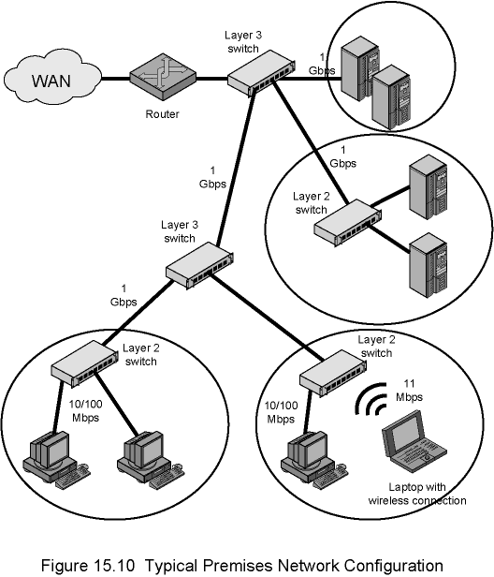
Typical (Low Cost) Local Network Configuration

Slide 52
100Mbps (Fast Ethernet)
100BaseT4
  to use voice grade cat 3 or cat 5 cables (but designed for cat 3)
  3 pairs in each direction with 33.3 Mbps on each using a ternary signalling scheme (8B6T = 8 bits map to 6 trits)
    total 4 pairs (2 of them bidirectional)
100Base-X
  Unidirectional data rate of 100 Mbps
  Uses two links (one for transmit, one for receive)
  Two types: 100Base-TX and 100Base-FX
100Base-TX
  cat5 UTP (one pair in each direction)
  at 125 Mhz with special encoding that has 20% overhead
    4 bits are encoded using 5-bit time
100Base-FX
  Optical fiber (one at each direction)
  Similar encoding

Slide 53
Fast Ethernet - Details
Same message format as 10 Mbps Ethernet
Fast Ethernet may run in full duplex mode
  So effective data rate per user becomes 200 Mbps
  Full duplex mode requires star topology with switches
In fact, shared medium no longer exists when switches are used
  no collisions, thus CSMA/CD algorithm no longer needed
  but stations still use CSMA/CD and same message format is used for backward compatibility reasons

Slide 54
Gigabit Ethernet
Strategy same as Fast Ethernet
  New medium and transmission specification
  Retains CSMA/CD protocol and frame format
  Compatible with 10 and 100 Mbps Ethernet
Why gigabit Ethernet?
  10/100 Mbps load from end users creates increased traffic on backbones
    so gigabit Ethernet is meaningful for backbones

Slide 55
Gigabit Ethernet – Physical
1000Base-SX
  Short wavelength, multimode fiber
1000Base-LX
  Long wavelength, Multi or single mode fiber
1000Base-CX
  A special STP (<25m)
    one for each direction
1000Base-T
  4 pairs, cat5 UTP (bidirectional)
  100 m

Slide 56
Gigabit Ethernet Medium Options (Log Scale)

Slide 57
10Gbps Ethernet
Why?
  same reasons: increase in traffic, multimedia communications. etc.
Primarily for high-speed, local backbone interconnection between large-capacity switches
Allows construction of MANs
  Connect geographically dispersed LANs
Variety of standard optical interfaces (wavelengths and link distances) specified for 10 Gb Ethernet
  300 m to 40 kms
  full duplex

Slide 58
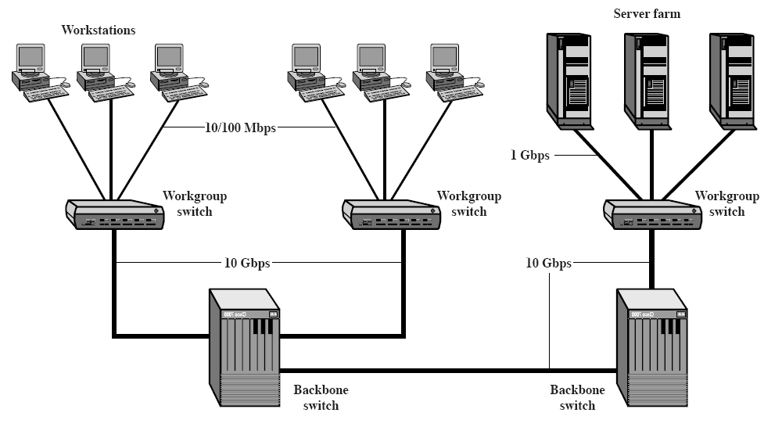
Example 10 Gigabit Ethernet Configuration

Slide 59
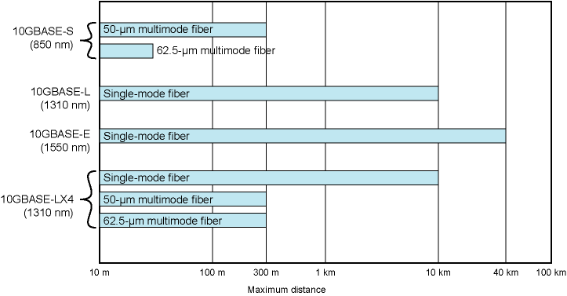
10-Gbps Ethernet Data Rate and Distance Options (Log Scale)
We also have copper alternatives.
10GBASE-T uses Cat 6 up to 55 m; Cat 6a (augmented Cat 6) up to 100 m.
Special encoding is used

Slide 60
40 and 100 Gbps Ethernet
Finally arrived
http://www.ieee802.org/3/ba/public/index.html
  IEEE P802.3ba 40Gb/s and 100Gb/s Ethernet Task Force
Standardization process is finished in June 2010
  IEEE Std 802.3ba-2010
  Later, 802.3bg-2011, 802.3bj-2014 and 802.3bm-2015 standards
Several products exist (fiber optic based)

Slide 61
Minimum frame size compatibility
For 10 Mbps Ethernet minimum frame size is
  64 octets as discussed before
  Main reason: sender should not finish sending a frame before max rtt (round trip time/delay)
    2500 meters for 10Base5 coax
    What about 10BaseT?
      Link is 100 meters. Does it cause a change in min frame length?
      NO! because the delay is shorter in 10BaseT
What happens for faster Ethernet?
  Faster means more bits are transmitted during rtt; that means larger min frame size if rtt is not reduced sufficiently
  But min frame size should not change for compatibility reasons
  rtt reduced due to reduced segment length in some configurations, but this may not be sufficient all the time
    Lets see if 64 octets is sufficient for
      100Base-TX (100 m max segment length) – See the details on board
      1000Base-T (100 m max segment length) – See the details on board

Slide 62
Minimum frame size compatibility – Solutions
From Tanenbaum, section 4.3.8
Reduce segment length
  Not practical! Should reduce to ~50m for gigabit ethernet
Two practical solutions appeared in standards
  Carrier extension
    Sending hardware adds more padding, receiving hardware removes. Thus the standard Ethernet frame remains the same
    Not good for efficiency due to extra padding overhead
  Frame bursting
    Sender concatenates several frames
    If needed hardware adds more padding

Slide 63
Optional Reading Assignment
Wireless LANs
  Section 15.6, pages 534 – 542
  Not responsible

